Slide 1
HIDDEN SURFACE REMOVAL

Slide 3
Hidden surface removal
Eliminate the surface that could not be visible
Floating Horizon
Z-buffer
Ray tracing

Slide 4
Floating horizon
A surface F(x,y,z)=0
Slice at different Z values
F(x, y, z_{a})=0
F(x, y, z_{b})=0
F(x, y, z_{c})=0
.
.
.
Y
Z
X
Z
Z_{c}
Z_{b}
Y
Z_{a}
X

Slide 5
Z₅
BACK
Z₄
Z₃
Y
Z₂
Z₁
FRONT
X

Slide 6

+Y
Z₁
Z₂
Z₃
Z₅
-Y
Z₄

Slide 7
Algorithm
At given point(x ,y)
if y value of a curve is larger than y value of all previous curve
or
if y value of a curve is smaller than y value of all previous curve
Then the point (x ,y) is visible
Z₅
BACK
Z₄
Z₃
Y
Z₂
Z₁
FRONT

Slide 8
Z-Buffer
Intensity
f(x ,y)
INTENSITY
Depth
Z(x ,y)
DEPTH

Slide 9
Z_{c}
Z_{b}
Z
Y
Z_{a}
(x,y)
X

Slide 10
Algorithm
α | α | α | α | α | α | α | α
α | α | α | α | α | α | α | α
α | α | α | α | α | α | α | α
α | α | α | α | α | α | α | α
α | α | α | α | α | α | α | α
α | α | α | α | α | α | α | α
α | α | α | α | α | α | α | α
α | α | α | α | α | α | α | α
BG | BG | BG | BG | BG | BG | BG | BG
BG | BG | BG | BG | BG | BG | BG | BG
BG | BG | BG | BG | BG | BG | BG | BG
BG | BG | BG | BG | BG | BG | BG | BG
BG | BG | BG | BG | BG | BG | BG | BG
BG | BG | BG | BG | BG | BG | BG | BG
BG | BG | BG | BG | BG | BG | BG | BG
BG | BG | BG | BG | BG | BG | BG | BG
DEPTH BUFFER
FRAME BUFFER

Slide 11
10
10 | 10
9 | 9 | 9
8 | 8 | 8 | 8
7 | 7 | 7 | 7 | 7
6 | 6 | 6 | 6 | 6 | 6
INTENSITY
DEPTH

Slide 12
 |  |  | 7
 |  |  | 7 | 7
 |  |  | 7 | 7
 |  |  | 7 | 7 | 7
 |  |  | 7 | 7 | 7
 |  |  | 7 | 7 | 7 | 7
 |  |  | 7 | 7 | 7 | 7 | 7
 |  |  | 7 | 7 | 7 | 7 | 7
INTENSITY
DEPTH

Slide 13
 |  |  | 4 | 4
 |  |  | 4 | 4
 |  |  | 4 | 4
 |  |  | 4 | 4
 |  |  | 4 | 4
 |  |  | 5 | 5
 |  |  | 5 | 5
 |  |  | 5 | 5
INTENSITY
DEPTH

Slide 14
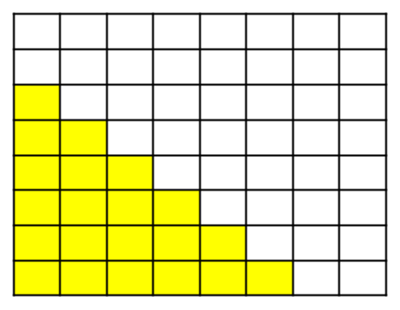
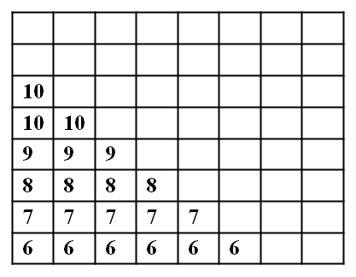
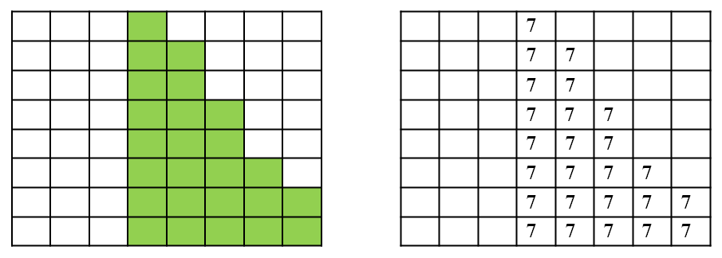
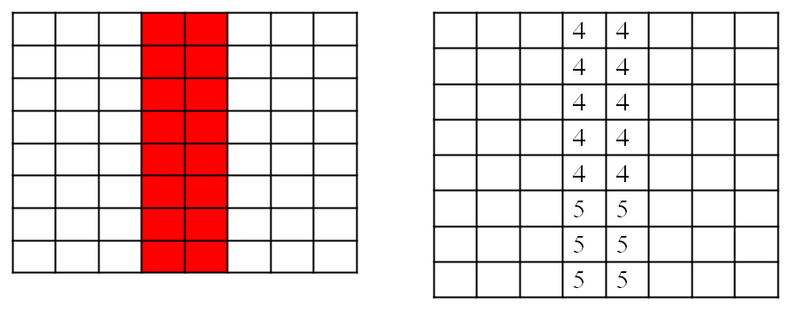
α | α | α | 4 | 4 | α | α | α
α | α | α | 4 | 4 | α | α | α
10 | α | α | 4 | 4 | α | α | α
10 | 10 | α | 4 | 4 | 7 | α | α
9 | 9 | 9 | 4 | 4 | 7 | α | α
8 | 8 | 8 | 5 | 5 | 7 | 7 | α
7 | 7 | 7 | 5 | 5 | 7 | 7 | 7
6 | 6 | 6 | 5 | 5 | 7 | 7 | 7
DEPTH BUFFER
BG | BG | BG |  |  | BG | BG | BG
BG | BG | BG |  |  | BG | BG | BG
 | BG | BG |  |  | BG | BG | BG
 |  | BG |  |  |  | BG | BG
 |  |  |  |  |  | BG | BG
 |  |  |  |  |  |  | BG
FRAME BUFFER

Slide 15
Ray Tracing
OBJECT
SOURCE
CAMERA

Slide 16
BACKWARD RAY TRACING
Camera shoots rays
Rays get reflected and intercepted by camera
Closest intersection is visible

Slide 17
Algorithm
S_{R}
P
(x_{C} ,y_{C}, z_{C})
(x ,y, z)
R_{D}
R₀
R₀=(x₀,y₀,z₀)
R_{D}=(x_{D},y_{D},z_{D})

Slide 18
Ray equation
We consider the ray towards the scene not opposite to the scene
We consider normalized direction of the ray i.e. perpendicular to the viewer’s plane
Sphere equation

Slide 19
Put the ray equation into sphere equation and solve t
We get
Find the value of closest t from R₀

Slide 20
END OF CHAPTER

